Slide 1
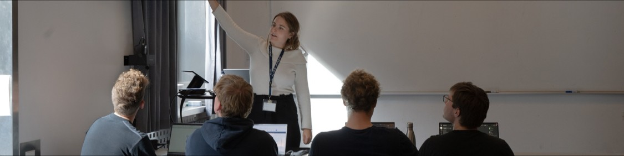
Breaking Down
Barriers to Programming
Caroline Berger
PhD Student, Human-Centred Computing Group, Aarhus University
11.05.2026

Slide 2
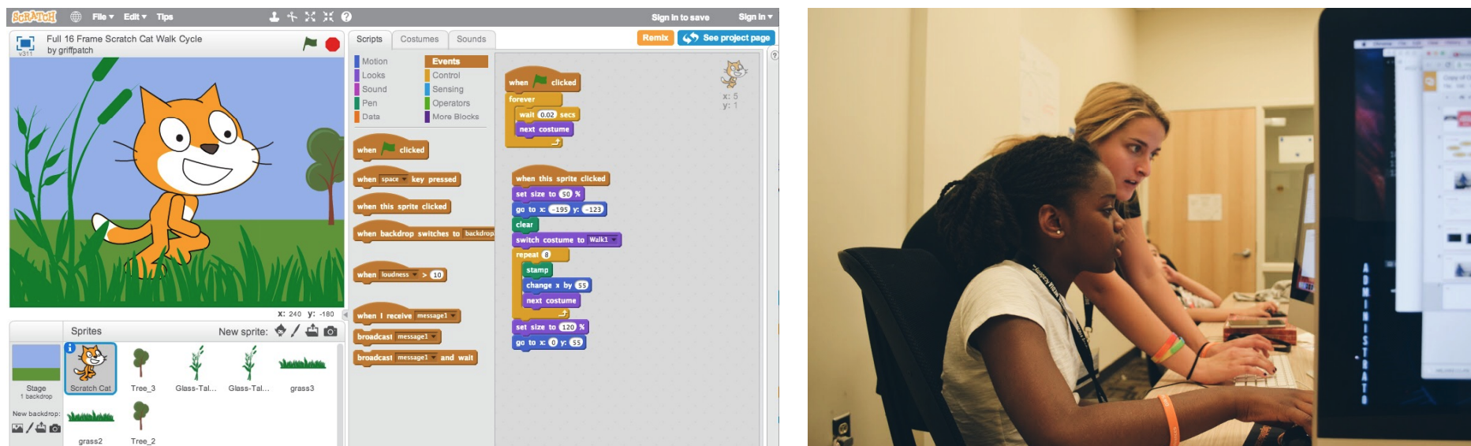
Pedagogical Programming Environments
Scratch, MIT
Caroline Berger | caroline.berger@cs.au.dk | ‹#›

Slide 3
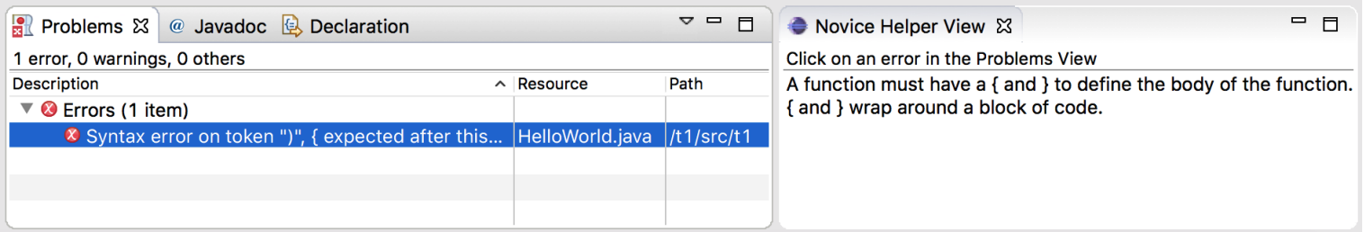
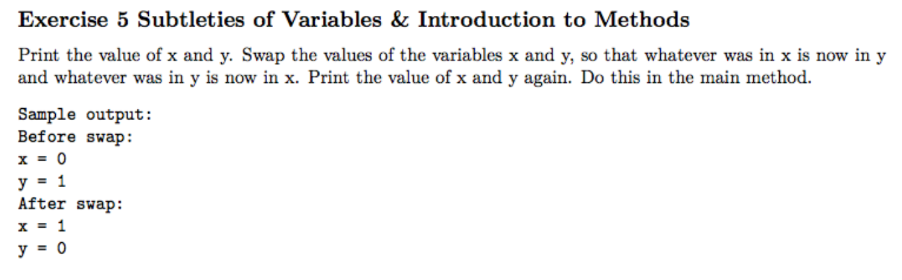
Learning Tools for Novices
Caroline Berger | caroline.berger@cs.au.dk | ‹#›

Slide 4
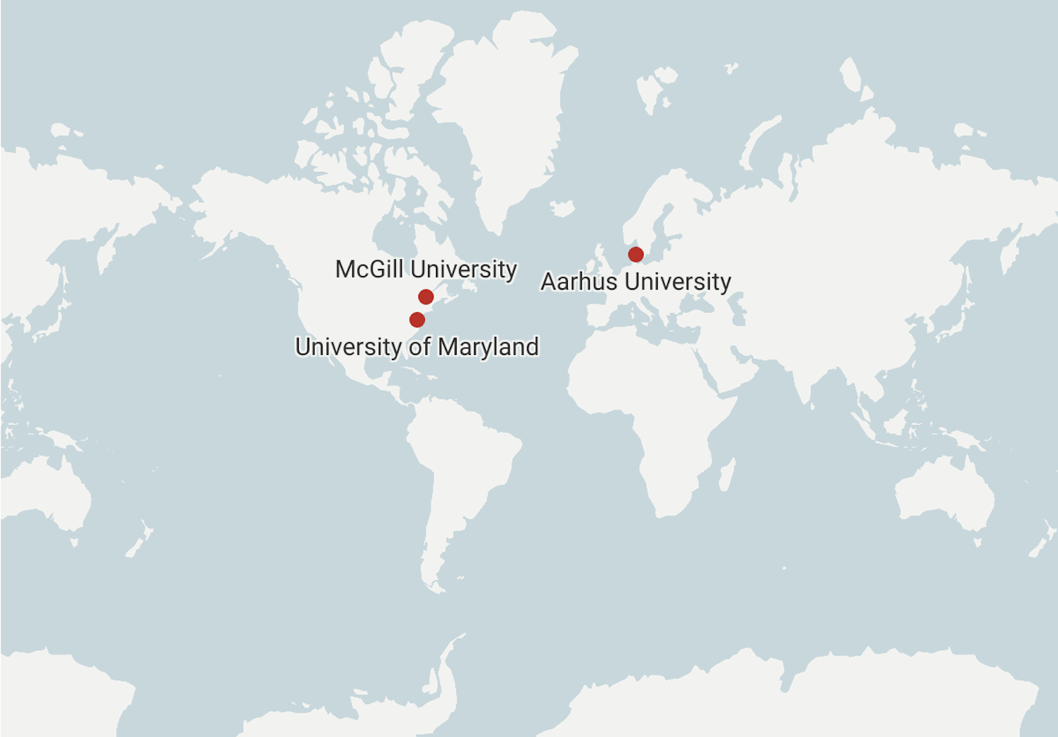
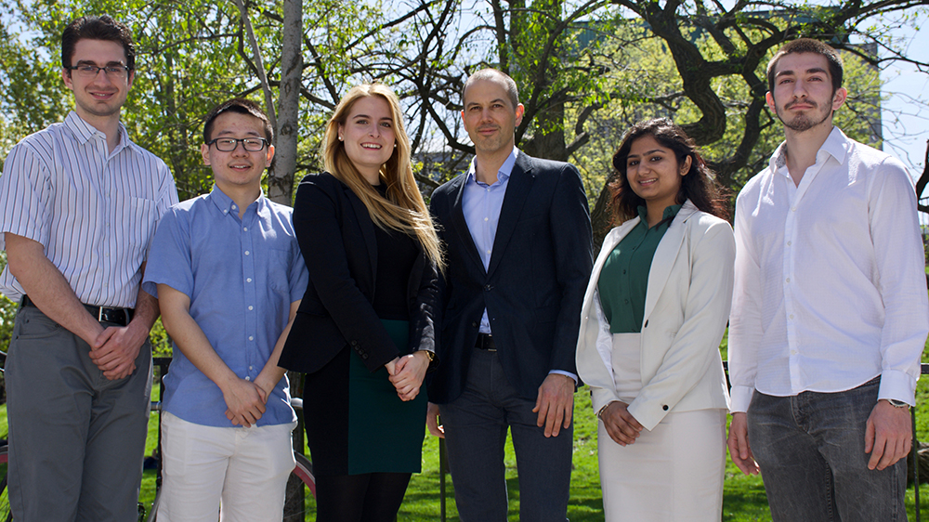
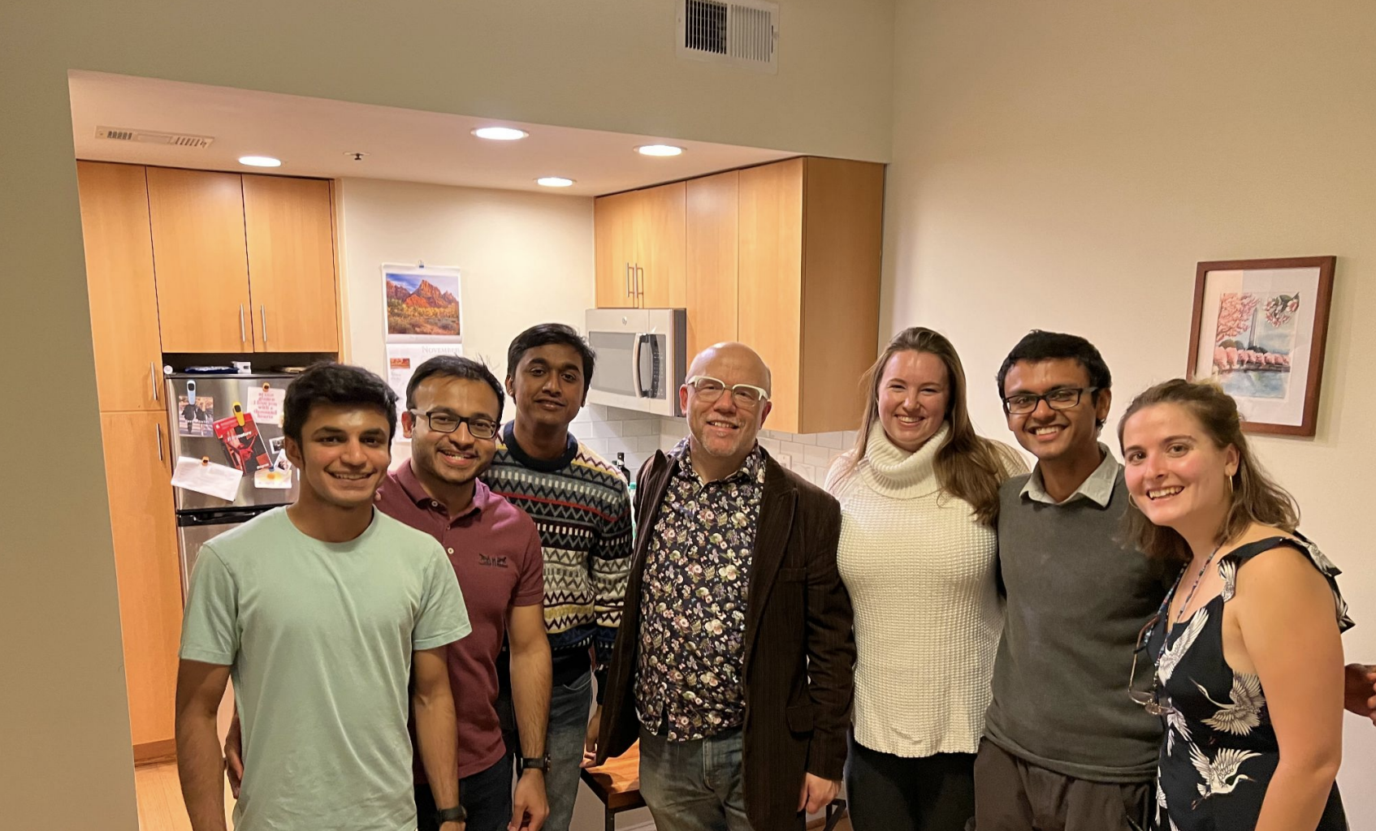
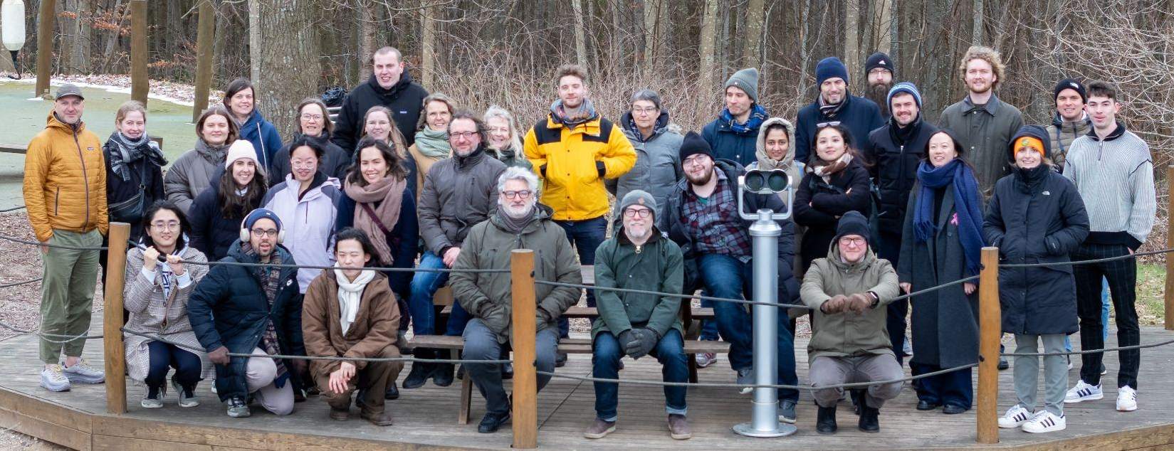
Research Environments
Caroline Berger | caroline.berger@cs.au.dk | ‹#›

Slide 5
Motivation
“...20 million people write the software that shapes the digital experiences of the 7.5 billion people on Earth [that] is [a] concentration of power second only to global income inequality”
- Amy Ko, 2018
Caroline Berger | caroline.berger@cs.au.dk | ‹#›

Slide 6
Pillars of my work
Tools
Skills
Contexts
Caroline Berger | caroline.berger@cs.au.dk | ‹#›

Slide 7
Live Coding - Scientific Programming - AI Assisted Programming

Slide 8
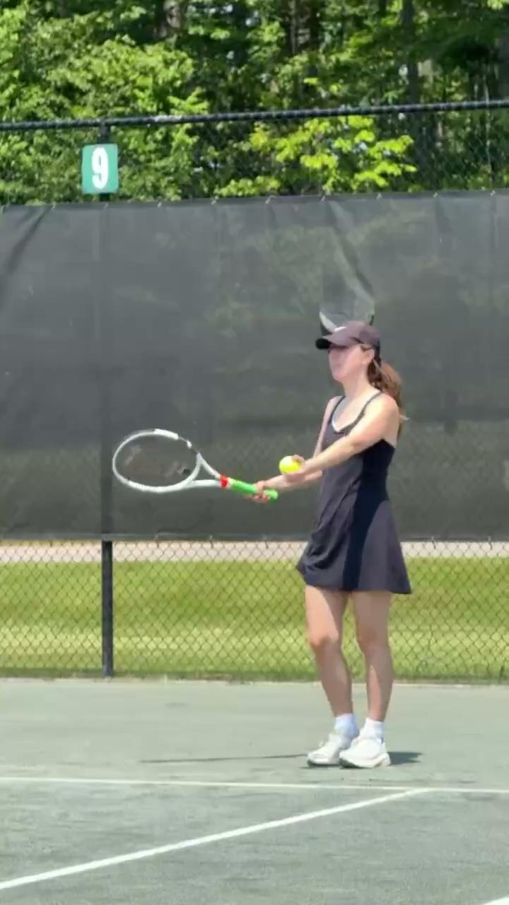
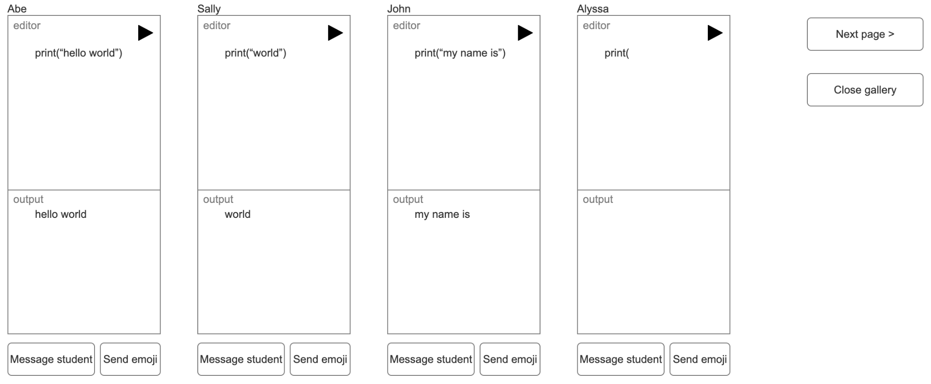
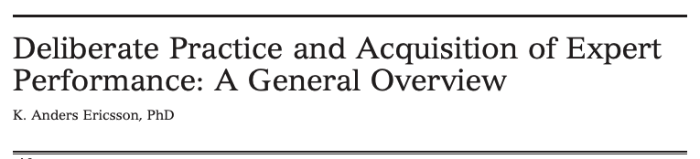

Timely Feedback in Live Coding
Live Coding
Berger, “I Feel Like I’m Teaching in a Gladiator Ring”: Barriers and Benefits of Live Coding,
University of Maryland, 2023
Caroline Berger | caroline.berger@cs.au.dk | ‹#›

Slide 9
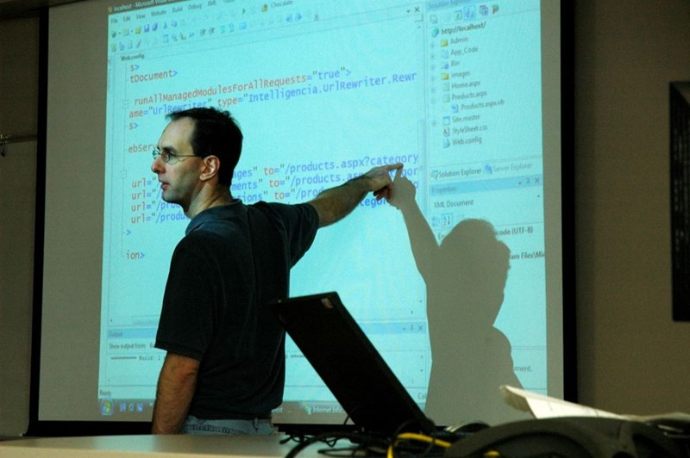

Directing Attention in Live Coding Tools
Live Coding
“But from the sort of neurodiversity side, the biggest problem with live coding is just keeping up, for dyslexics, keeping up with what's being written and understanding what's being written... So specifically, I think making sure that the student knows what they're looking at. So asking does everyone understand? Does everyone see? Having that back and forth to make sure that the students are actually looking at what you want them to look at. And also specifically saying things like ignore this bit, we want to focus on this specific method or even just zooming in so that only one method is being looked at, I think could be extremely helpful.”
Teaching Assistant at a large public North American University, 2023
Caroline Berger | caroline.berger@cs.au.dk | ‹#›

Slide 10
Live Coding - Scientific Programming - AI Assisted Programming

Slide 11
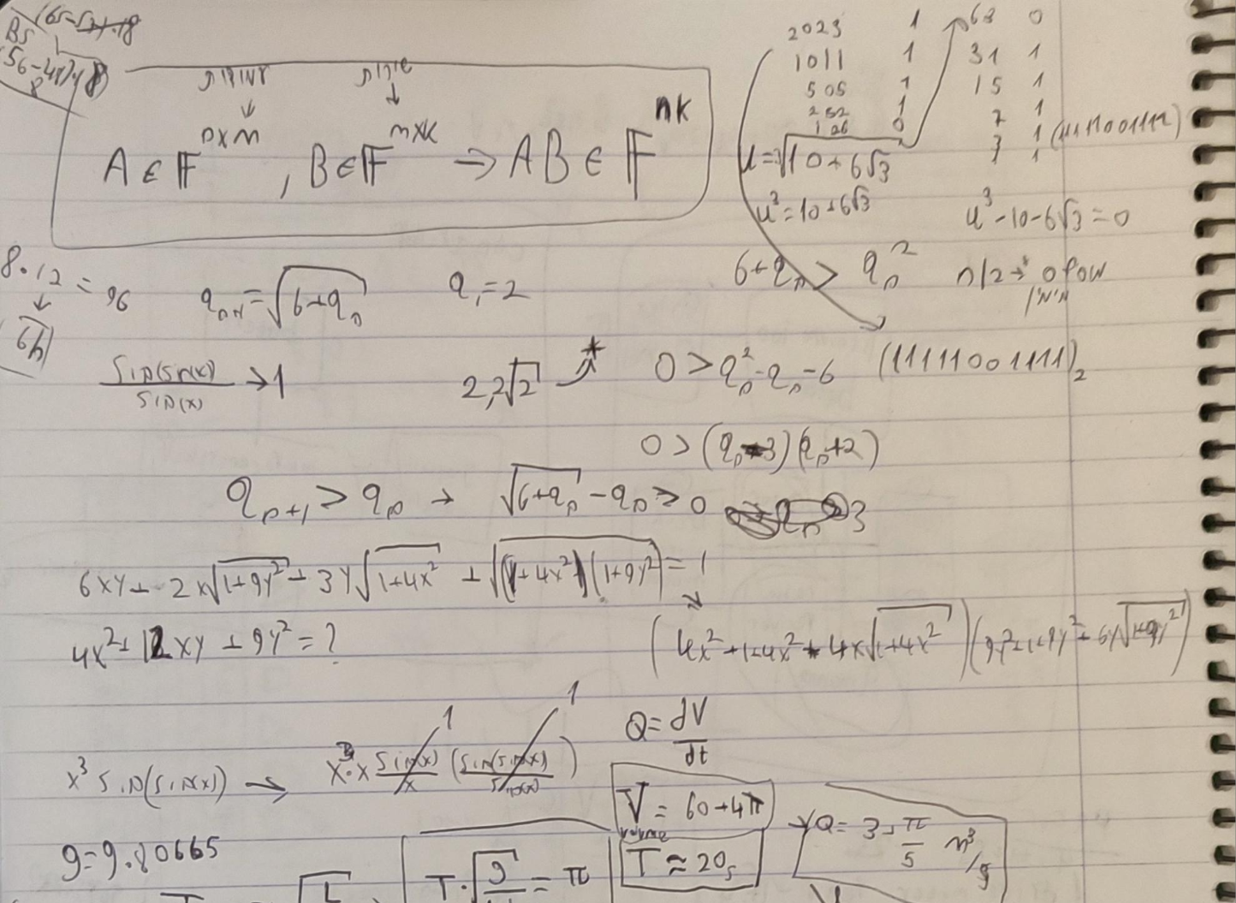
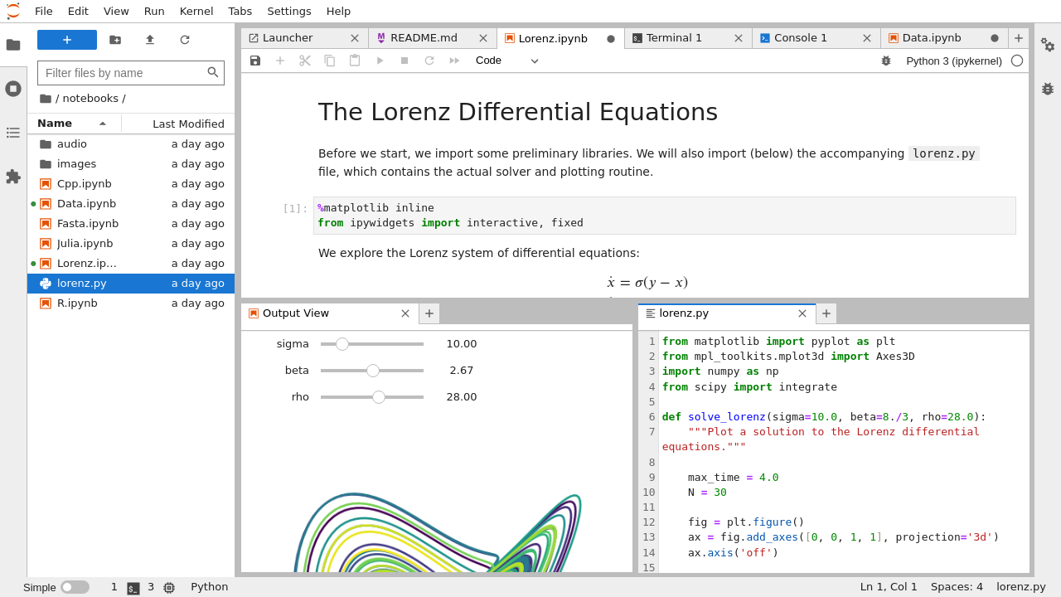

Real Scientific Work
Programs as Fancy Calculators
Scientific Programming
Berger, Caroline, et al. "Scientists and Code: Programming as a Tool." PLATEAU: 14th Annual Workshop at the Intersection of PL and HCI , 2024.
Caroline Berger | caroline.berger@cs.au.dk | ‹#›

Slide 12
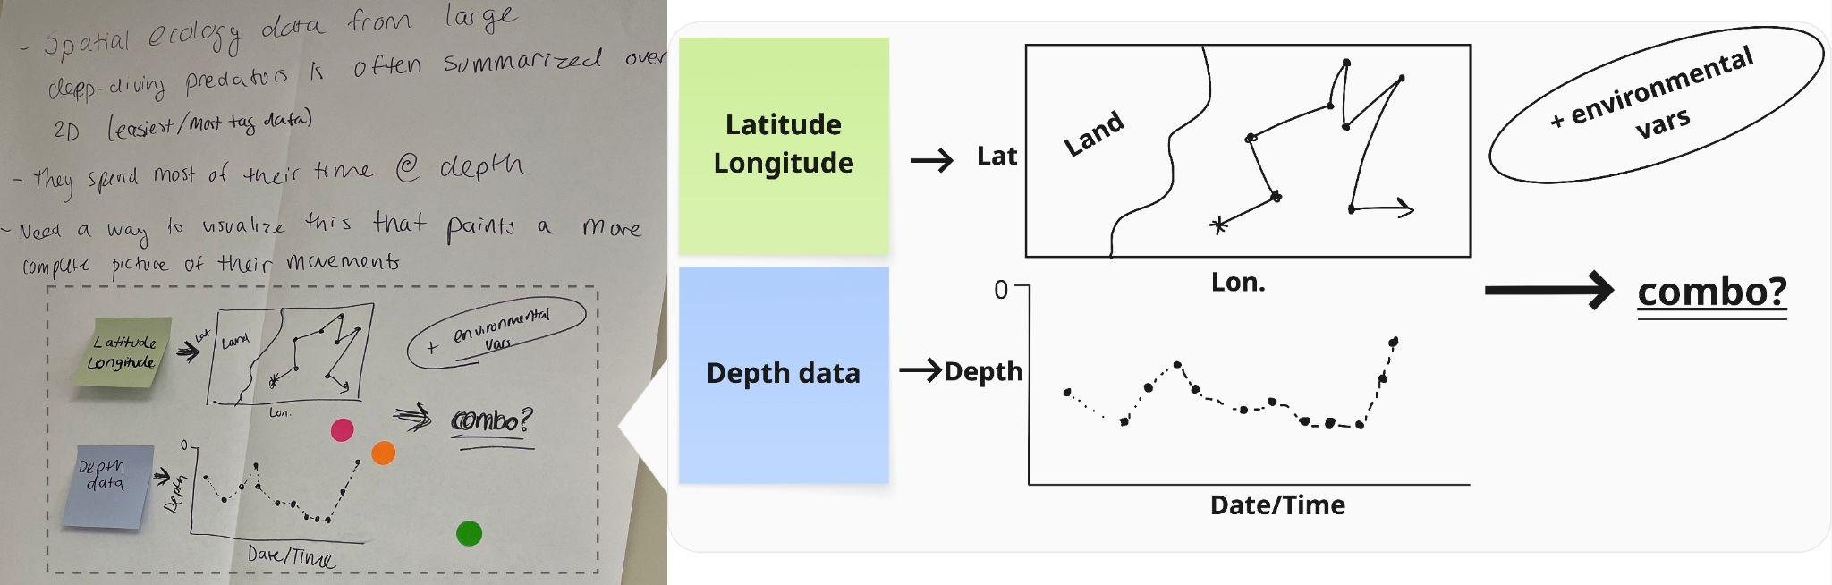
Complete and Accurate Picture of their Science
Scientific Programming
Postdoctoral Fellow at large North American Oceanographic Research Institute, she specializes in large predatory animals, 2025
Caroline Berger | caroline.berger@cs.au.dk | ‹#›

Slide 13
Live Coding - Scientific Programming - AI-Assisted Programming

Slide 14
Perspectives on Vibe Coding
AI-Assisted Programming
“...I am worried about losing my coding skills, to be honest I have sort of given up on this, but for a while I still wanted to be able to code cleanly and nicely and I felt too much reliance on AI was making me lose my skills... A bit tied to above, but before with copy pasting, I ended up in situations where my code base was half my crappy code and half AI very clean but perhaps overly complex code, which made me not want to use AI as, even if the code works, it was just harder to understand and debug. Now with mostly pure vibe coding, I have just surrendered to it's stylistic preferences.”
PhD student in Physical Oceanography at a European University, teaches programming and uses python, JS, HTML & CSS
Caroline Berger | caroline.berger@cs.au.dk | ‹#›

Slide 15

Vibe Coding Interactive Tools for
Ocean Science Communication and Analysis
AI-Assisted Programming
Part 1: Tutorial - Ocean Science Conference
Part 2: Follow up 6 weeks
What’s changed?
Caroline Berger | caroline.berger@cs.au.dk | ‹#›

Slide 16
Plugin for Novice Programmers
Scientists Programming
Vibe Coding
2017
2024
2026
2023
2025
Live Coding
Authoring Interactive Visualizations
What comes next?
Caroline Berger | caroline.berger@cs.au.dk | ‹#›

Slide 17
Future Work

Slide 18
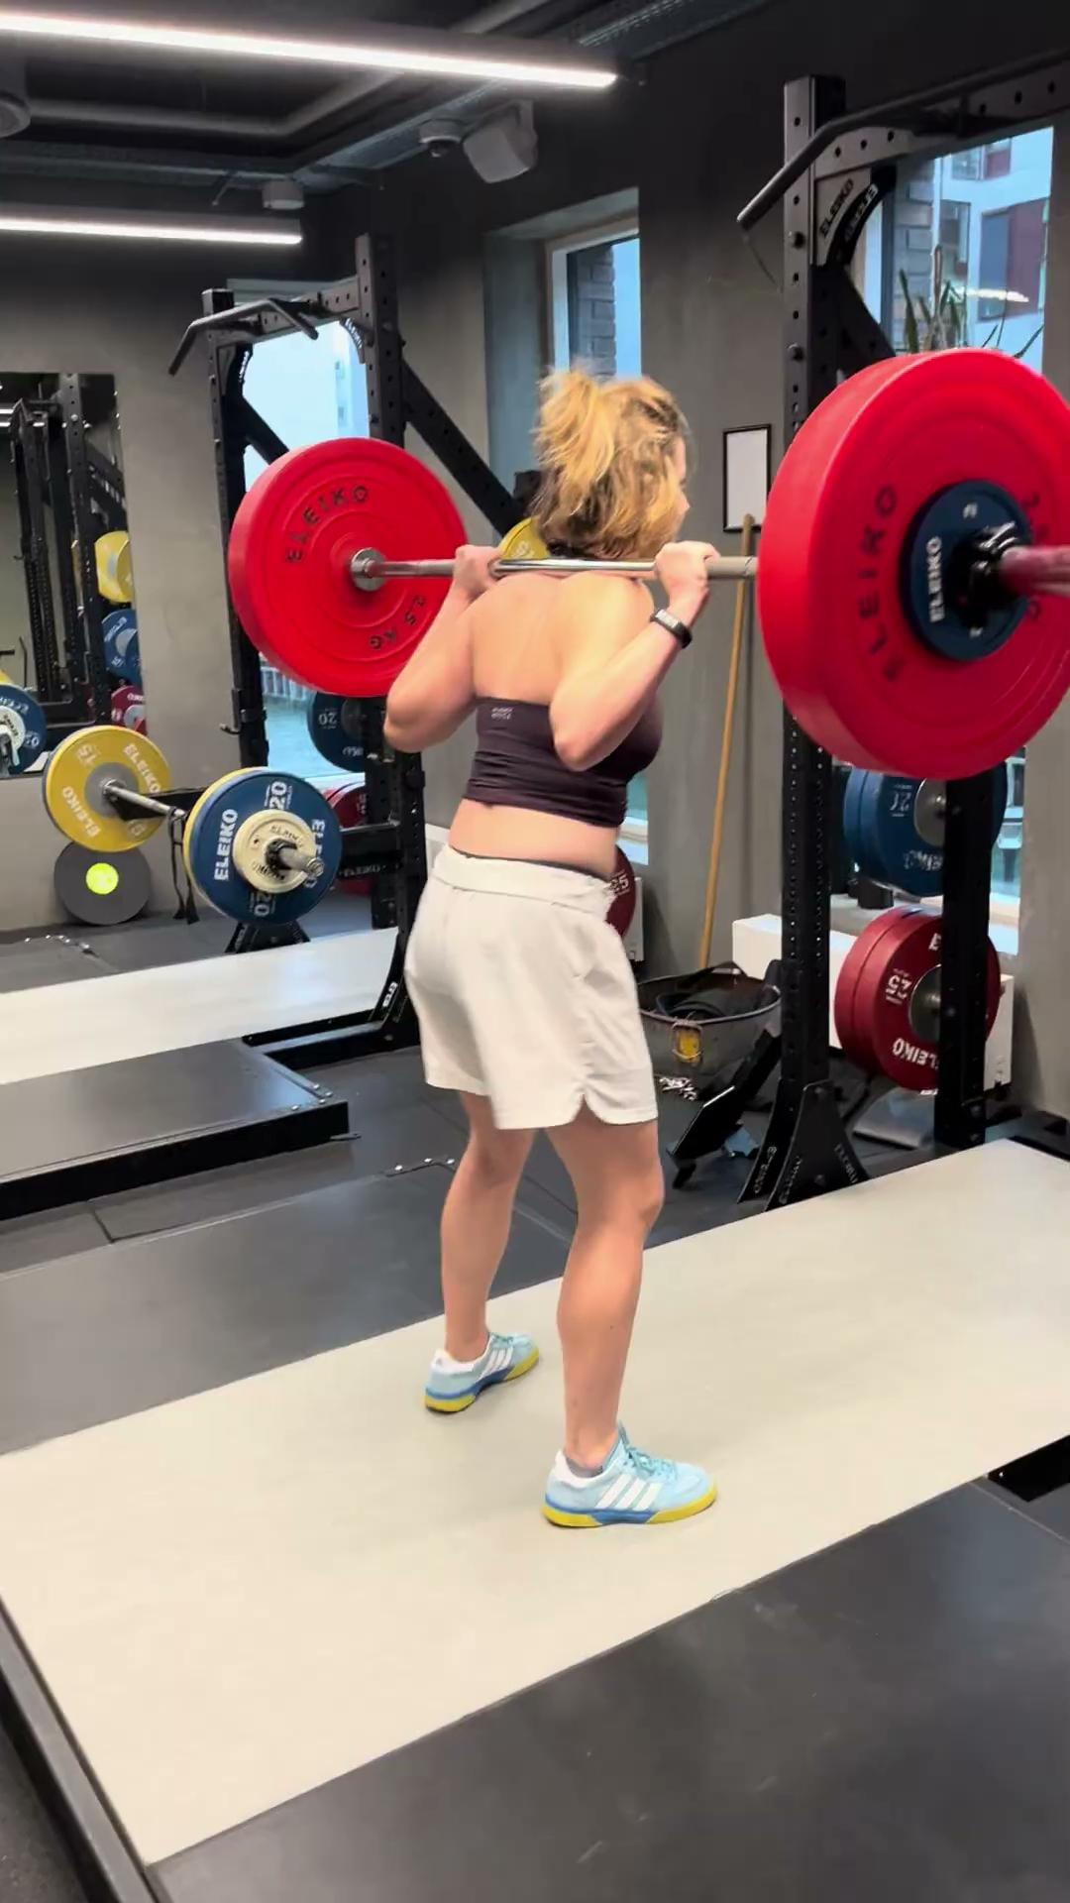
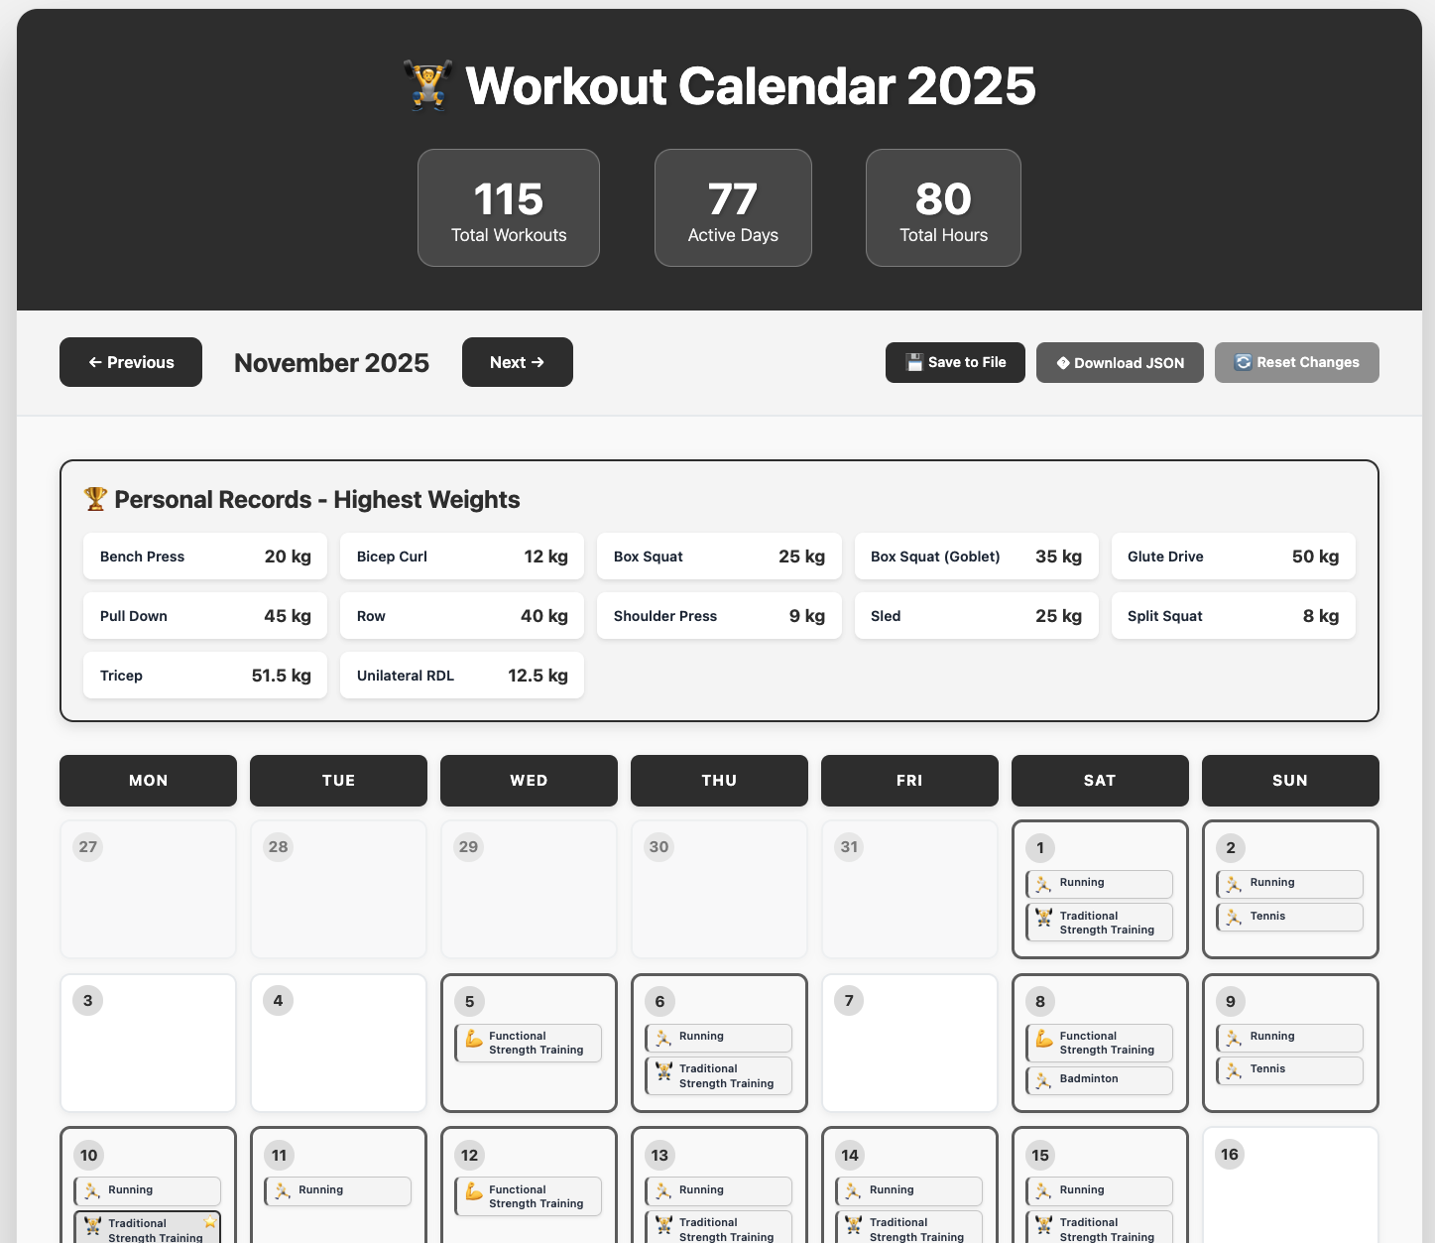
Reprogrammable Women-Centric Software
Future Work
Caroline Berger | caroline.berger@cs.au.dk | ‹#›

Slide 19
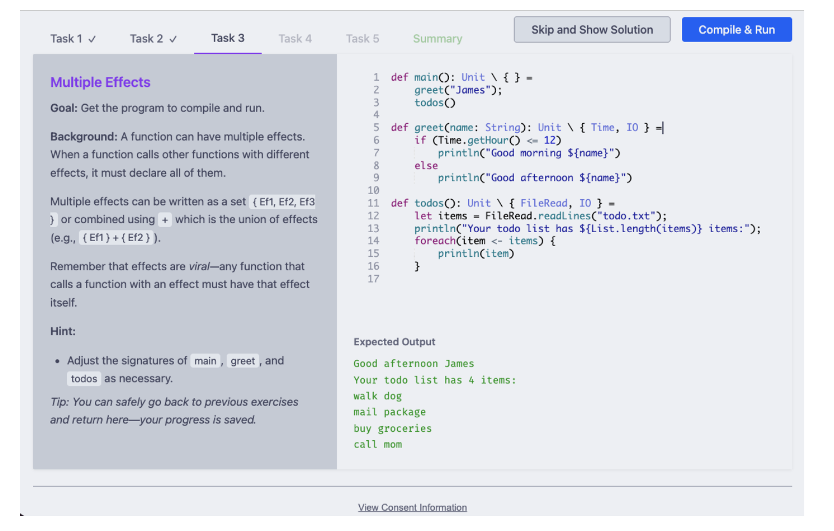
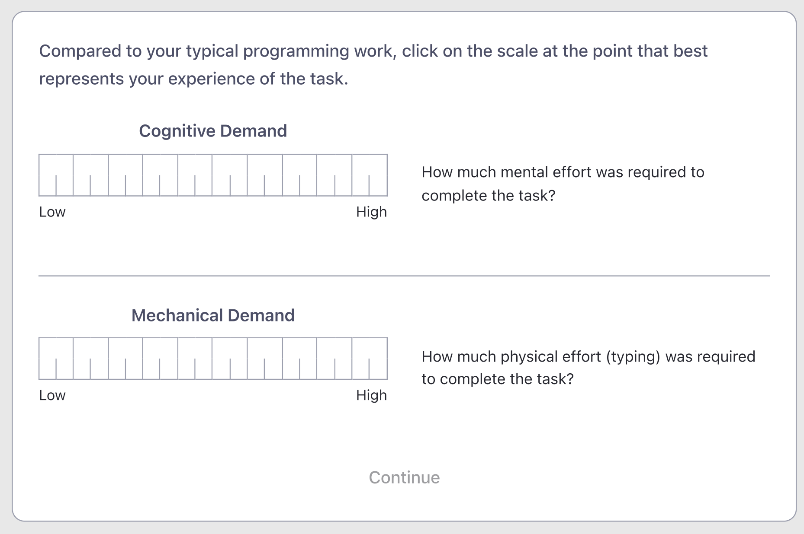
Methods for Evaluating Programming Languages and Tools
Future Work
Caroline Berger | caroline.berger@cs.au.dk | ‹#›

Slide 20
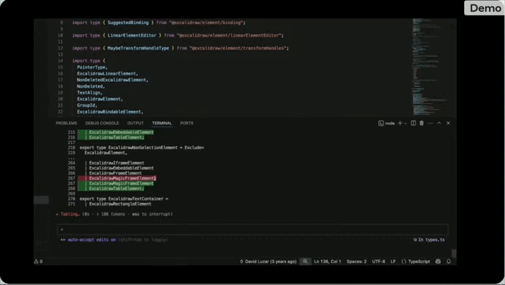

Gesture Supported Coding
Future Work
Caroline Berger | caroline.berger@cs.au.dk | ‹#›

Slide 21
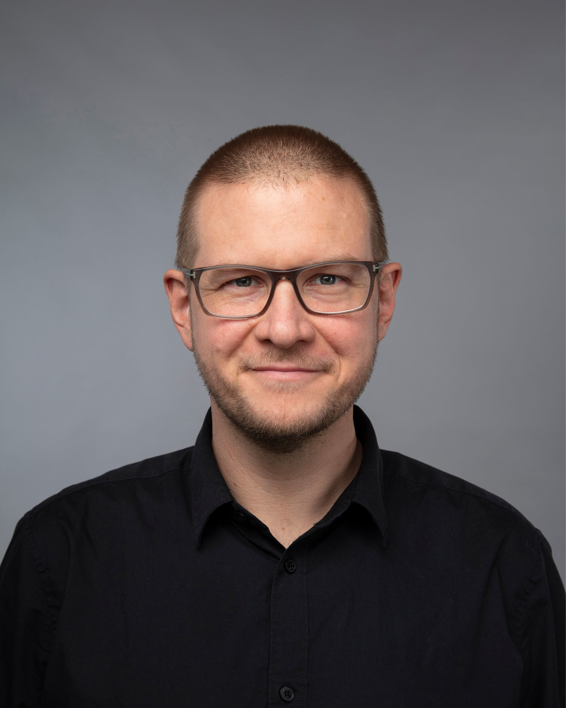
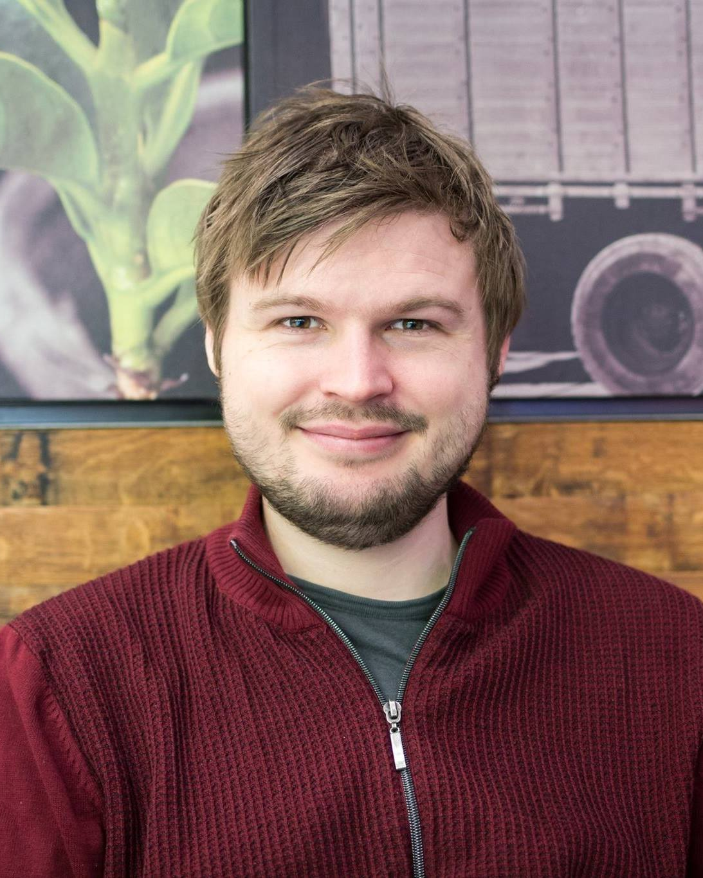
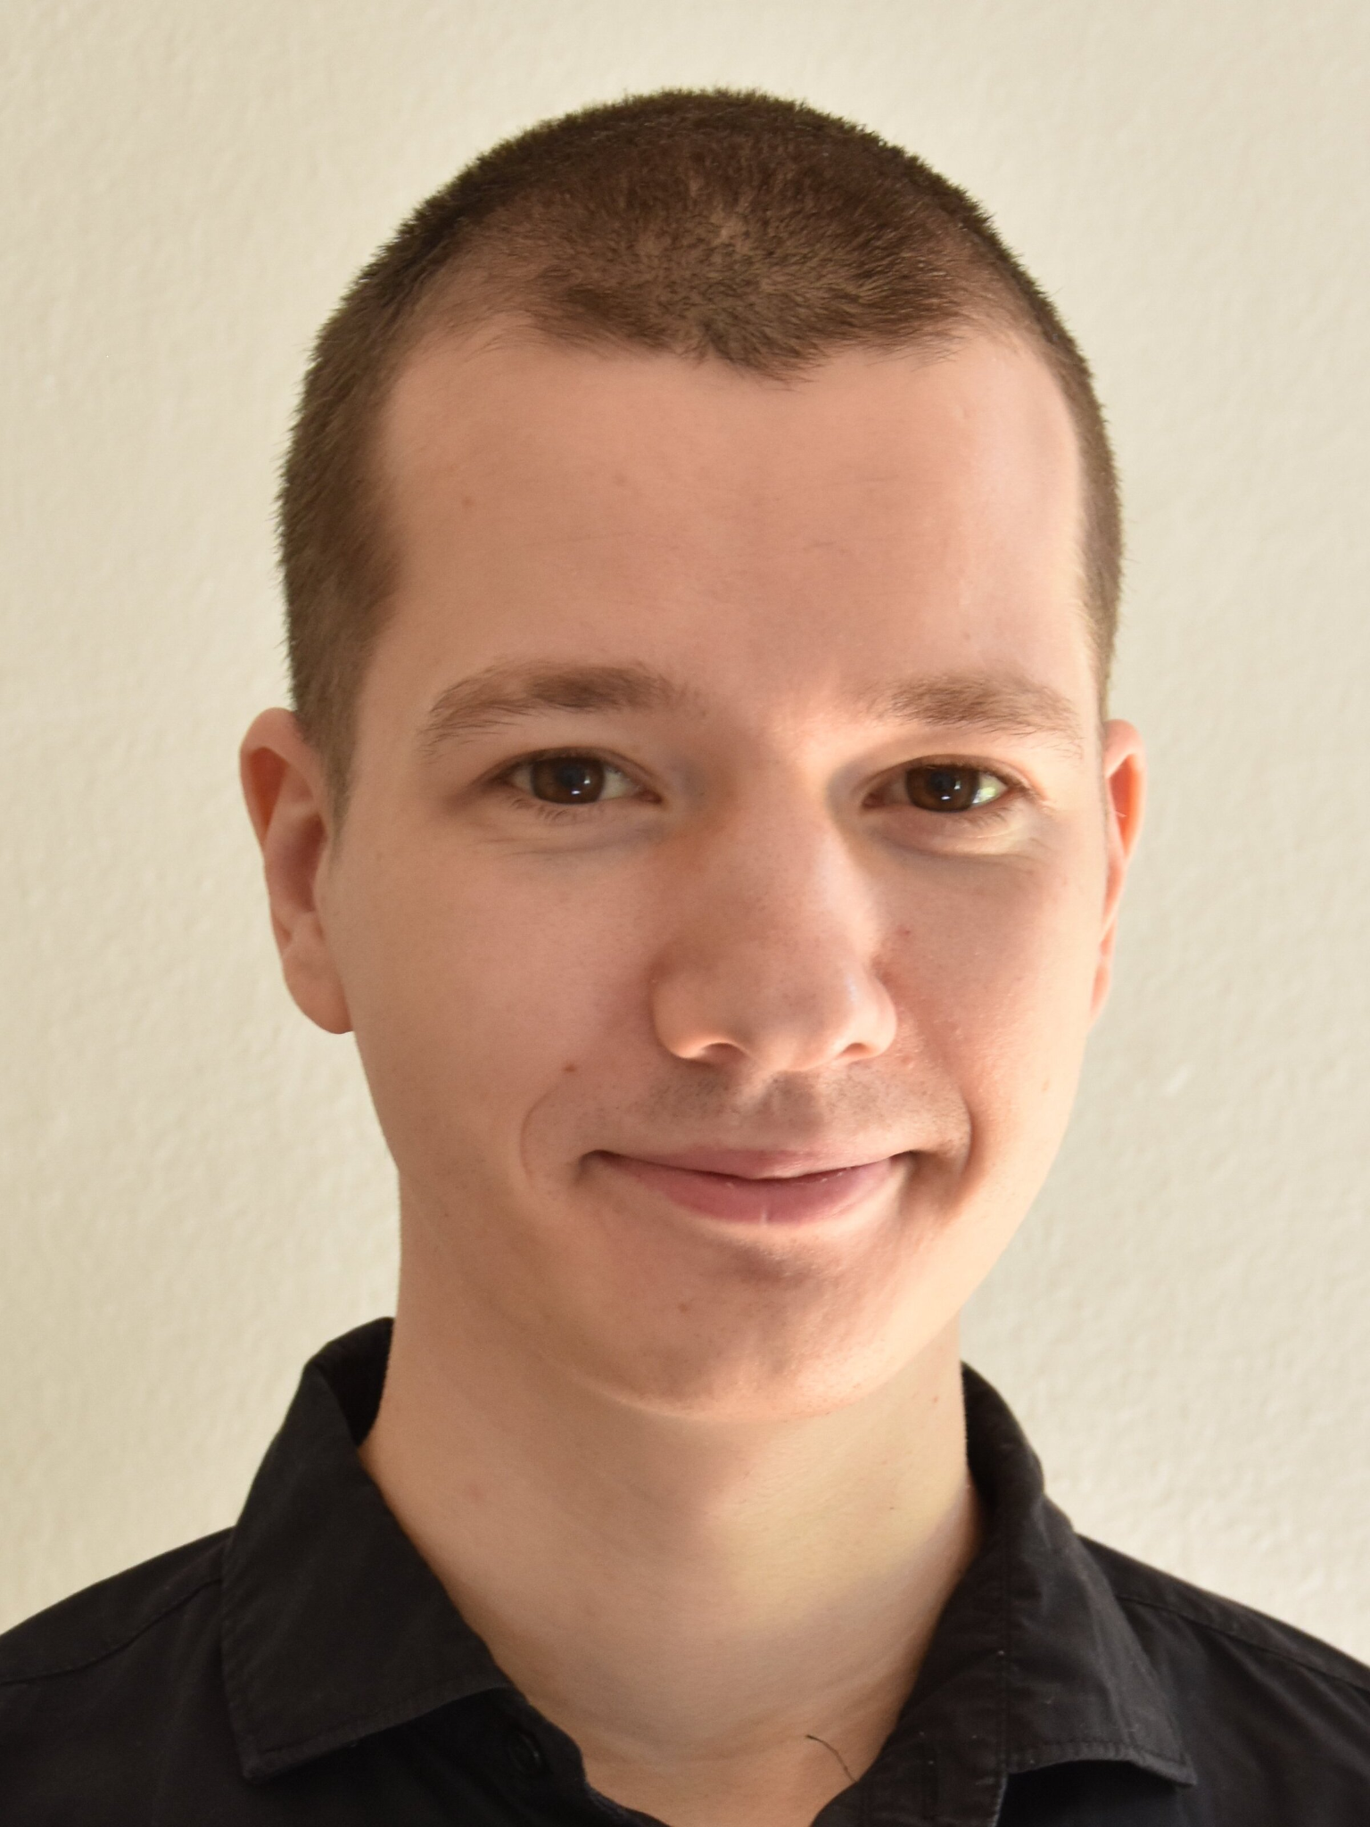

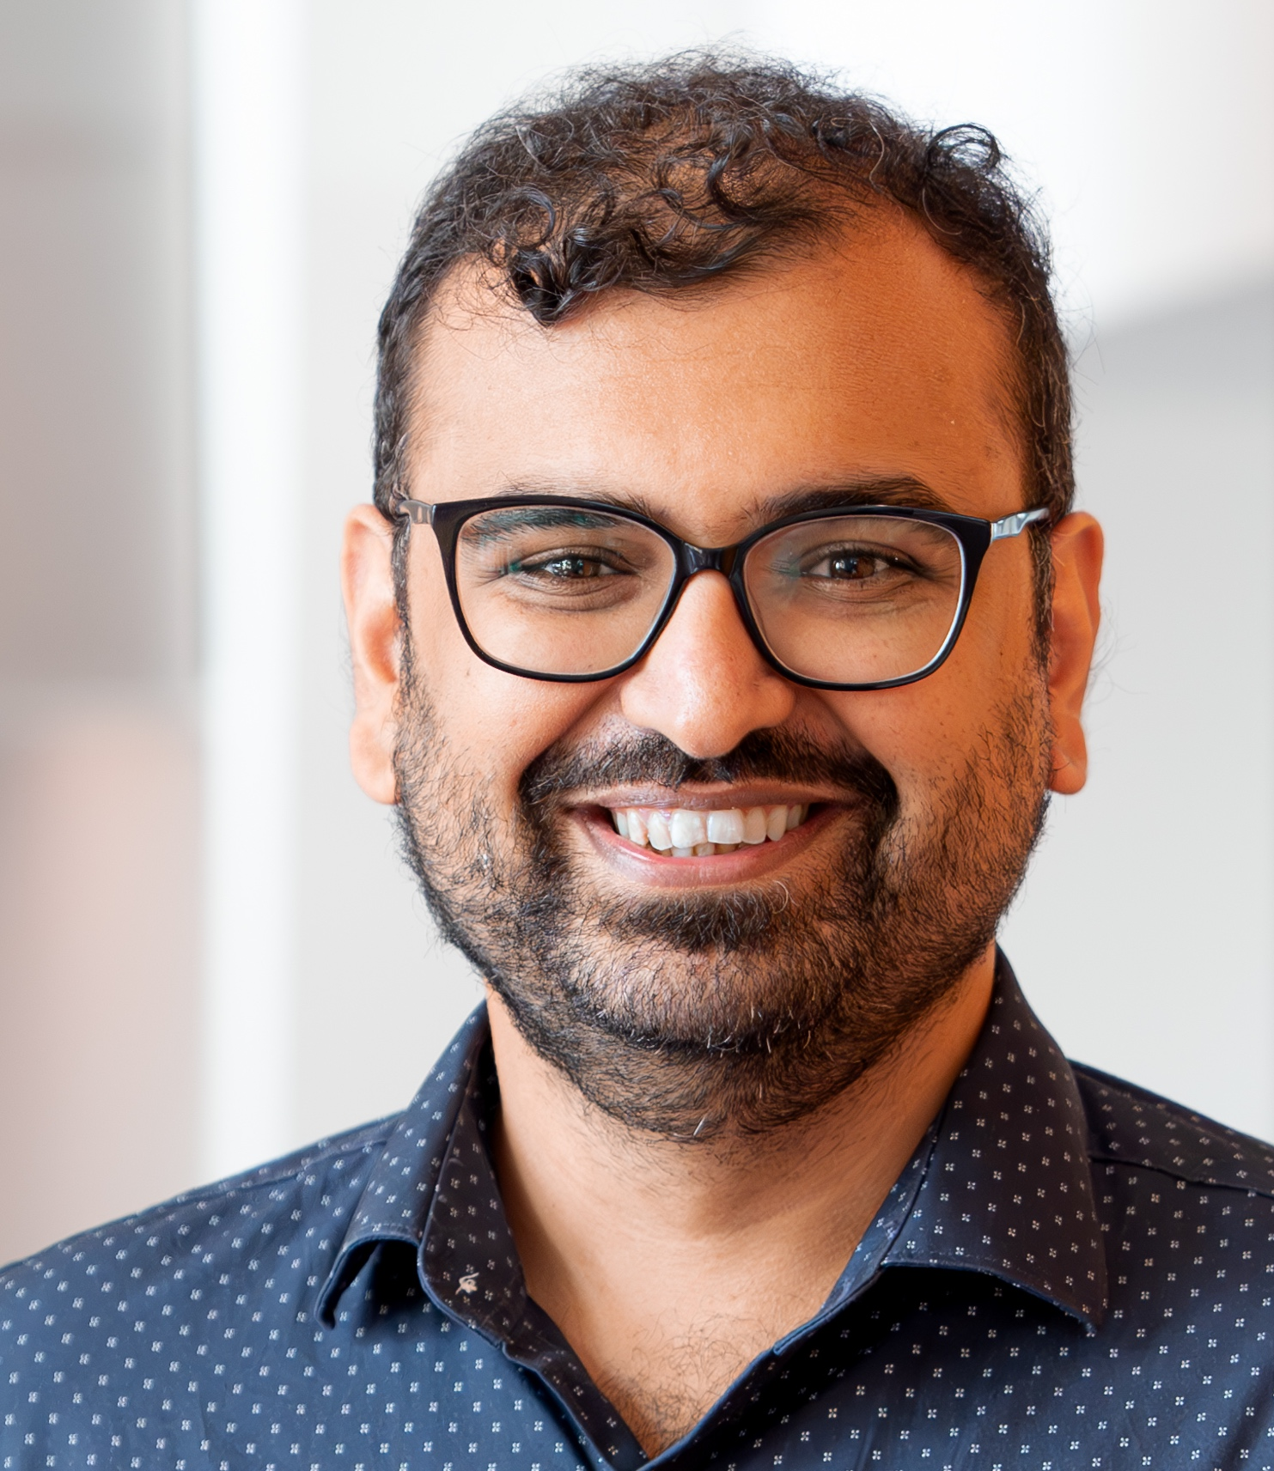

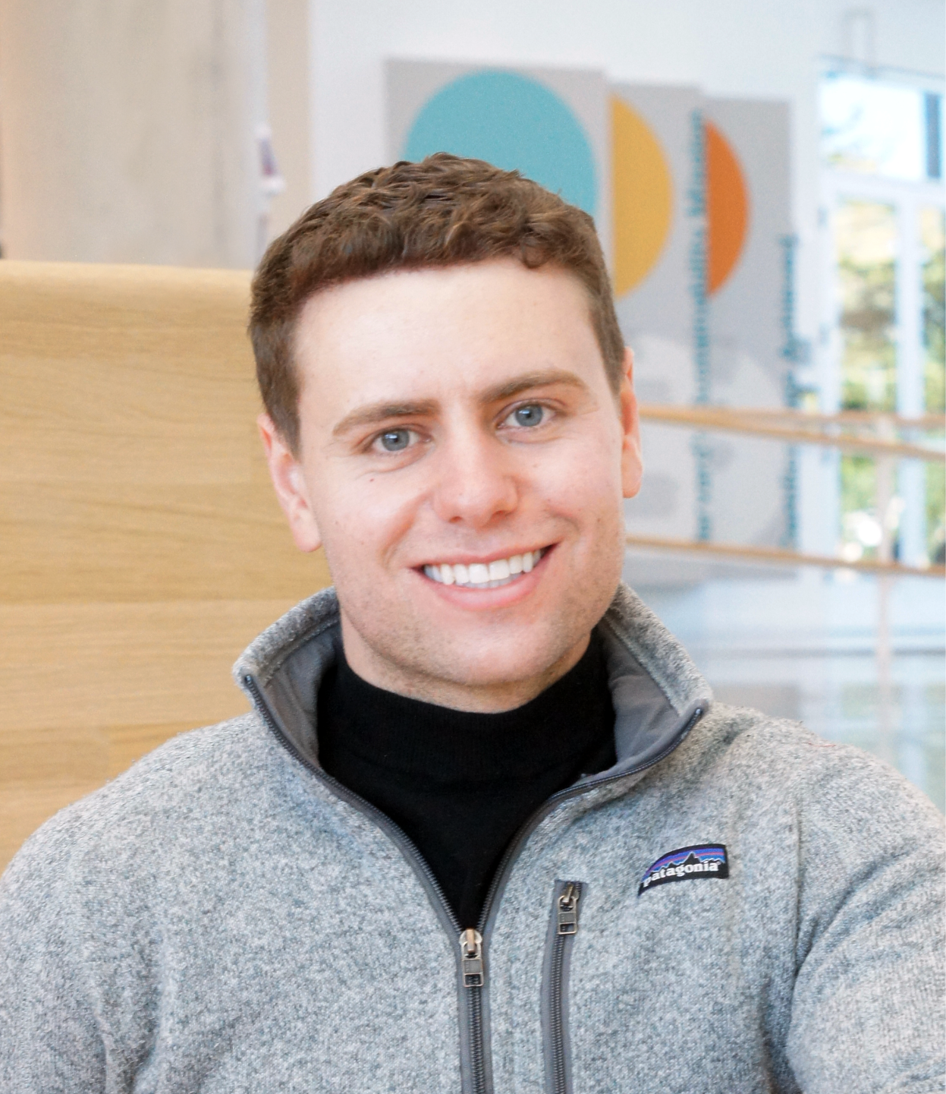

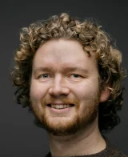
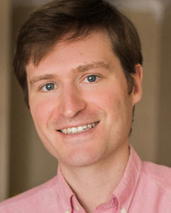

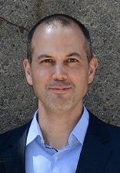
Caroline Berger
PhD Student, Human-Centred Computing Research Group
Aarhus University
caroline.berger@cs.au.dk
carolineberger.github.io
Seeking postdoctoral
opportunities for
Jan. 2027

